Slide 1
EcoSLIM
Princeton GPU Hackathon
Jun Zhang, U of Arizona
Hoang Tran, Princeton U
Chen Yang, Princeton U
Mentors
Troy Comi, Princeton U
Carl Ponder, NVIDIA

Slide 2
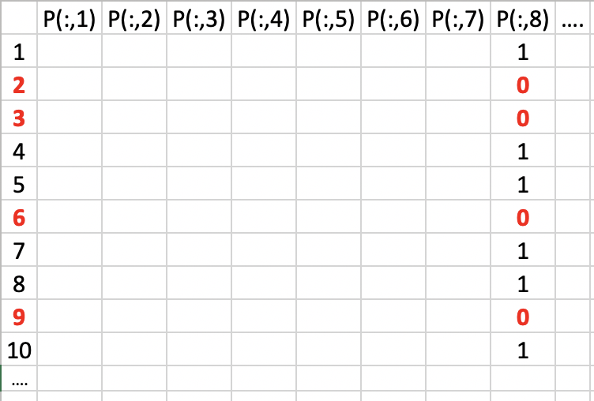
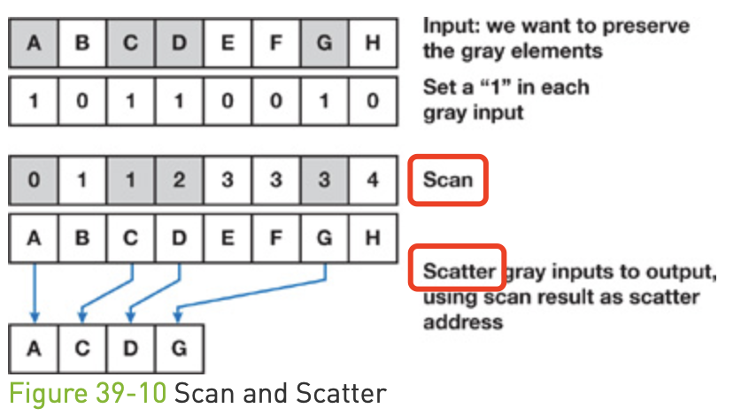
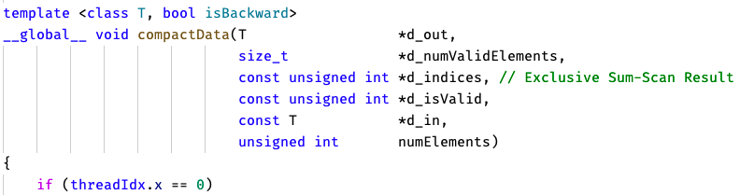
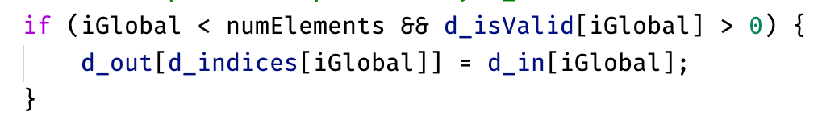
Goals
Scatter in cudpp
1D array
For scan: writing a wrapper to call exclusive_scan in Thrust which is a CUDA C++ template library;
For scatter: modifying the kernel from cudpp to handle 2D particle array P;
For scatter: writing a wrapper to call this CUDA C++ kernel in Fortran; Or probably rewrite it in CUDA Fortran;
Test and profile scan and scatter using restart files generated in previous simulations;
Using cmake, Nsight, etc.

Slide 3
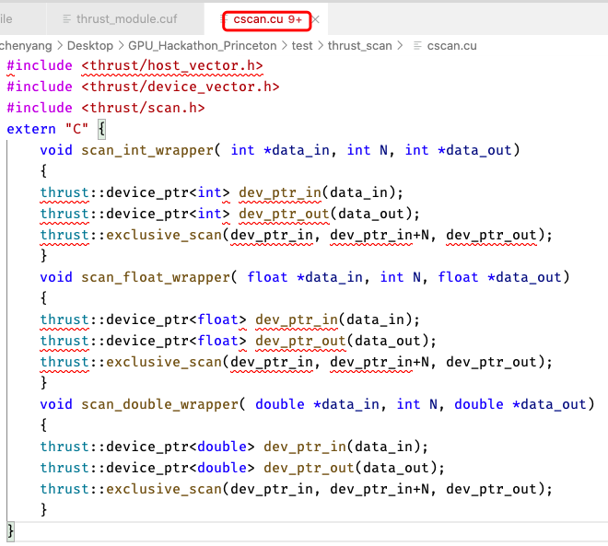
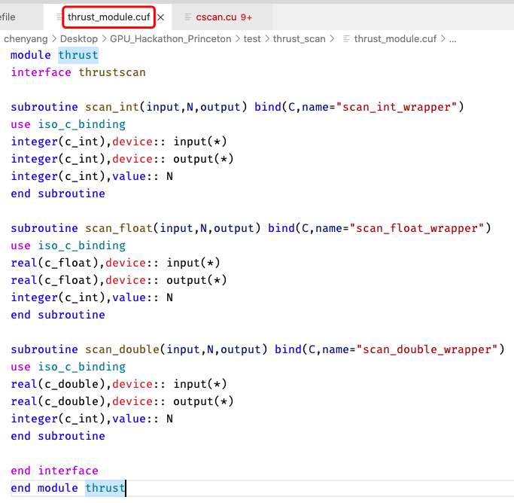
Wrapper Functions

Slide 4
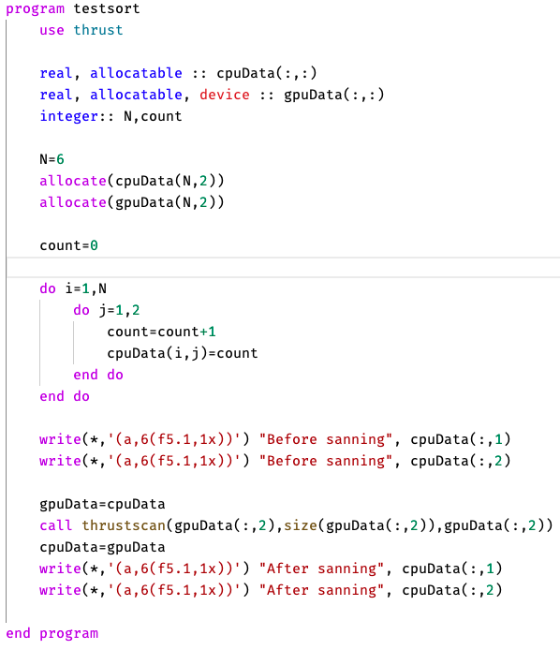
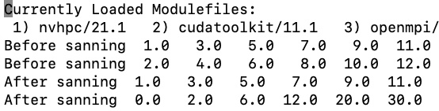
Results
Column 2
Column 2
Column 2

Slide 5
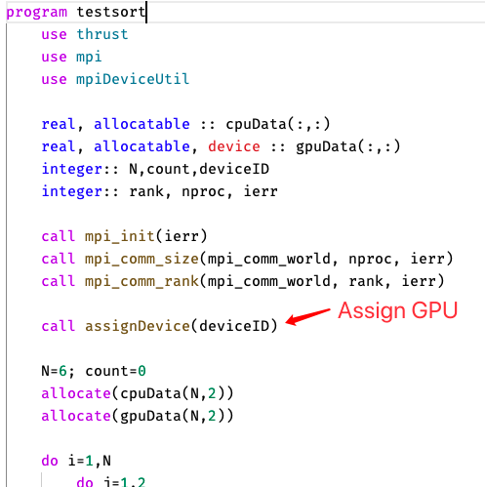
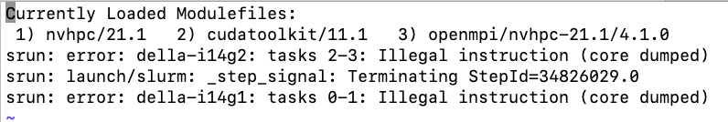
Problems
What problems are you currently facing? MPI failed

